Slide 1
Chapter three
Class & Objects

Slide 2
3.1. Introduction
Classes
A set of similar objects is called a class.
Model objects that have attributes (data members) and behaviors (member functions)
Defined using keyword class
Have a body delineated with braces ({ and })
Example: public Student{….}
Each .java source file may contain only one public class. A source file may contain any number of default visible classes.
Finally, the source file name must match the public class name and it must have a .java suffix.
Object
An Object represents a real world entity. It is complete and self contained with distinct characteristics and behaviors.
Is a unique instance of one class
Eg: Student s1=new Student (“Abebe”,20)
S1:-is an object

Slide 3
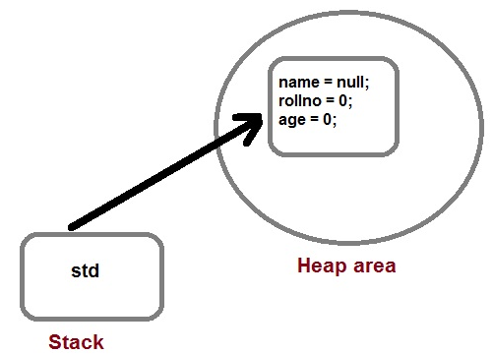
Cont…
Eg:
class Student. { String name; int rollno; int age; }
Student std=new Student();
The new operator dynamically allocates memory for an object

Slide 4
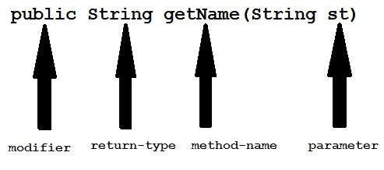
Cont…
Methods
Method describe behavior of an object.
A method is a collection of statements that are group together to perform an operation.
Syntax :
return-type methodName(parameter-list) { //body of method }
Example
public String getName(String st)
{ String name="StudyTonight";
name=name+st; return name; }
Member Methods
Methods that are defined in the class and invoked using the class object
Eg: public int getAge():-is a member function
Static methods:
Methods that can be defined by using keyword static and can be called using simple function name or clasname.functionname
Eg: public static void disp();….
its function calling will be :disp()/clasname.disp()

Slide 5
Cont…
Constructor
A class contains constructors that are invoked to create objects from the class blueprint.
Constructor declarations look like method declarations—except that they use the name of the class and have no return type.
For example, Student constructor:
private String name; private int age;
public Student(String n, int a) {
name=n;
age=a;
}
To create a new Student object called s1, a constructor is called by the new operator:
Student s1=new Student (“Abebe”,20);//creates space in memory for the object and initializes its fields.

Slide 6
Cont…
We can also create a no-argument constructor/default-const:
public Student() {name=”abebe”; age=12;}
Difference b/n Constructors & Methods???
constructors can not return a value and are only called once (return current instant of a class)
while regular methods could be called many times and it can return a value or can be void.
Student s1=new Student (); invokes the no-argument constructor to create a new Student object (s1)
As with methods, the Java platform differentiates constructors on the basis of the number of arguments in the list and their types.(constructor overloading)
You cannot write two constructors that have the same number and type of arguments for the same class, because the platform would not be able to tell them apart. Doing so causes a compile-time error.
By default, the compiler automatically provides a no-argument,default constructor for any class without constructors.

Slide 7
3.2 Class Variables
The variable of any class are classified into two types;
Static or class variable
Non-static or instance variable
Static variable
Memory for static variable is created only one in the program at the time of loading of class.
These variables are preceded by static keyword. static variable can access with class reference.
static variable not only can be access with class reference but also some time it can be accessed with object reference.
Non-static variable
Memory for non-static variable is created at the time of create an object of class.
These variable should not be preceded by any static keyword Example: These variables can access with object reference.

Slide 8
Cont…
Static-variable
Non-static variable
preceded by static keyword.
class A
{
static int b;
}
They are common for every object /there memory location can be sharable by every object reference or same class.
Static variable can access with class reference.
Syntax:class_name.variable_nam
No static keyword-EG:
class A
{
int a;
}
They are specific to an object
They can access with object reference.
Syntax
obj_ref.variable_name

Slide 9
cnt’d…
Non-static variable
Static-variable
Memory is allocated for these variable whenever an object is created
Memory is allocated multiple time whenever a new object is created.
Non-static var/instance var because memory is allocated whenever instance is created.
Memory is allocated for these variable at the time of loading of the class.
Memory is allocated for these variable only once in the program.
Static var/class-var Because Memory is allocated at the time of loading of class

Slide 10
Example-1
Student s2=new Student();
s2.roll_no=200;
s2.marks=75.8f;
s2.name="zyx";
System.out.println(s2.roll_no);
System.out.println(s2.marks);
System.out.println(s2.name);
System.out.println(Student.College_Name);
}
}
What will be the output?
class Student
{ int roll_no;
float marks;
String name;
static String College_Name="ITM"; }
class StaticDemo {
public static void main(String args[])
{
Student s1=new Student();
s1.roll_no=100;
s1.marks=65.8f;
s1.name="abcd";
System.out.println(s1.roll_no);
System.out.println(s1.marks);
System.out.println(s1.name);
System.out.println(Student.College_Name);

Slide 11
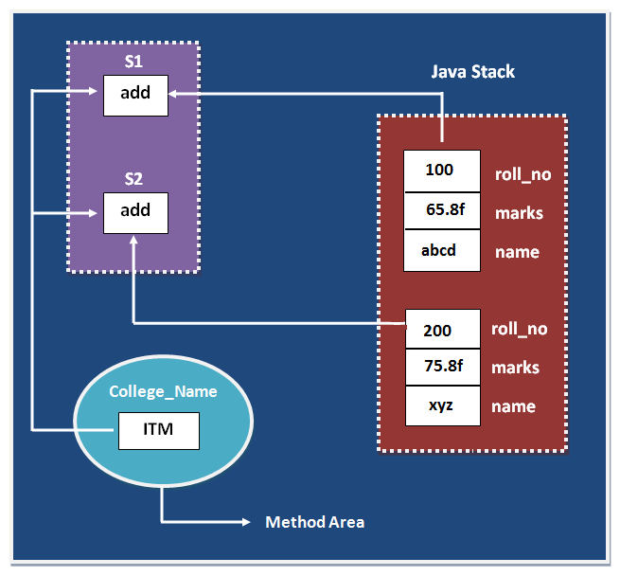
Pictorially:

Slide 12
Example-2 (predict output for both???)
class Counter
{
int count=0;// what if it is static int count=0;
Counter()
{
count++;
System.out.println(count);
}
public static void main(String args[])
{
Counter c1=new Counter();
Counter c2=new Counter();
Counter c3=new Counter();
}
}

Slide 13
3.3 Access Specifiers
The four access levels are −
Visible to the package, the default. No modifiers are needed.
Visible to the class only (private).
Visible to the world (public).
Visible to the package and all subclasses (protected).
Note:
a class cannot be associated with the access modifier private, but if we have the class as a member of other class, then the inner class can be made private.
outer classes can only be declared public or package private.
Use the most restrictive access level that makes sense for a particular member. (private )unless you have a good reason not to.
Avoid public fields except for constants.It is not recommended for production code. (Public fields tend to link you to a particular implementation)

Slide 14
Cont…
2. Private Access Modifier
Methods, variables, and constructors that are declared private can only be accessed within the declared class itself.
the most restrictive access level. Class and interfaces cannot be private.
Using the private modifier is the main way that an object encapsulates itself and hides data from the outside world.
Example:
public class Eg1 {
private String name;
public String getName() { return this.name; }
1. Default Access Modifier - No Keyword
we do not explicitly declare an access modifier for a class, field, method, etc.
A variable or method declared without any access control modifier is available to any other class in the same package.
Example:
Variables and methods can be declared without any modifiers, −
String version = "1.5.1";
boolean processOrder() { return true;}

Slide 15
Cont…
4. Protected Access Modifier
Variables, methods, and constructors, which are declared protected in a superclass can be accessed only by the subclasses in other package or any class within the package of the protected members' class.
The protected access modifier cannot be applied to class and interfaces.
Methods, fields can be declared protected, however methods and fields in an interface cannot be declared protected.
3. Public Access Modifier
A class, method, constructor, interface, etc. declared public can be accessed from any other class.
Therefore, fields, methods, blocks declared inside a public class can be accessed from any class belonging to the Java Universe.
However, if the public class we are trying to access is in a different package, then the public class still needs to be imported. Because of class inheritance, all public methods and variables of a class are inherited by its subclasses.
Example
public static void main(String[] arguments) { // ...}

Slide 16
Cont…
Protected access gives the subclass a chance to use the helper method or variable, while preventing a nonrelated class from trying to use it.
Example
its child class override openSpeaker() method −
class AudioPlayer {
protected boolean openSpeaker(Speaker sp) { // implementation details }}
class StreamingAudioPlayer
{//sub-class
boolean openSpeaker(Speaker sp)
{ // implementation details }}
What if it (openSpeaker) is declared as private? Or public?

Slide 17
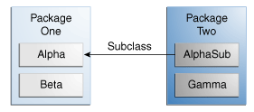
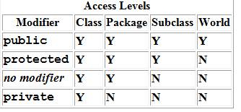
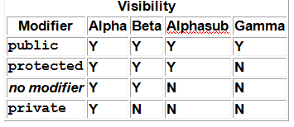
Summary
how access levels affect visibility in class relationships
Eg:-member of Alpha-class
The following table shows the access to members permitted by each modifier

Slide 18
Example-1(class & Objects)
public class simpleClass {
private String name;
private int age;
public simpleClass(String n,int a)
{
this.name=n; //what if there is setter methods?
this.age=a;
}
public String getName()
{ return name; }
public int getAge()
{ return age; }
public static void main(String args[])
{ simpleClass s1=new simpleClass("abe",12);
String n=s1.getName();
int a=s1.getAge();
System.out.println(n+"\t"+a);
}

Slide 19
Example-2(static-methods)
import java.util.Scanner;
public class Func1 {
public static void main(String[] args)
{ pr();
Func1.pr2();
}
public static void pr()
{ System.out.println("hello");}
public static void pr2()
{ int x,y,r;
Scanner s=new Scanner (System.in);
System.out.println ("enter...");
x=s.nextInt(); y=s.nextInt();
r=x+y;
System.out.println("res="+r);}
}

Slide 20
Exercises:
Define a class product with members(name, cost, qty & calcCost(),calcTax(),calcProf())
Input values
Using constructor
Using input from keyboard(Scanner/JOptionPane)
What if for N-products
Define four static methods of simple calculator(Arithemetics)
Input values
Using constructor
Using input from keyboard(Scanner/JOptionPane)

Slide 21
3.4 This and this()
this keyword
is used to refer always current object/current instance of a class,
this is a non static and can not be used in static context, which means you can not use this keyword inside main method in Java(compilation error)
this() method
is used to access one constructor from another where both constructors belong to the same class
With the both, inheritance is not involved; everything happens within the same class.
OR it can be used in constructor chaining to call another constructor
e.g. this() calls no argument constructor of child and parent class.
Note:
Another use of this in Java is for accessing instance variables of a class and it's parent (if it is the same instance-to remove ambiguity)
You can not reassign the (this variable) because you can not assign a new value to final variable this".-they are special variables and they are final

Slide 22
Examples-predict?
Eg-2
public class Officer
{ public Officer() {
this(“Second");
System.out.println(“I am First");
}
public Officer(String name) {
System.out.println("Officer name is " + name); }
public Officer(int salary) {
this();
System.out.println("Officer salary is Rs." + salary); }
public static void main(String args[])
{ Officer o1 = new Officer(9000);
}
Eg-1
public class Number
{ int num;
public void favorite(int num)
{ this.num = num;
}
public static void main(String args[])
{
Number n1 = new Number();
n1.favorite(8);
System.out.println("Your favorite number is " + n1.num);
}
}
What if num=num?

Slide 23
Cont…
The this is also used to call Method of that class.
public void getName()
{
System.out.println("Studytonight"); }
public void display()
{
this.getName();
System.out.println(); }
this is used to return current Object
public Car getCar()
{ return this; }

Slide 24
3.5 Mutable & Immutable Class
Mutable classes
We can change the state of object after initiation in case of mutable classes.
These classes are not thread safe so we should use proper synchronize block to access its member data(instance variable).
Its recommended to create getter and setter methods in mutable class to embrace Encapsulation.
With mutable objects you can change the state anytime during its lifetime (via the setters),
whereas with immutable objects you change only set its state when you create it (via the constructor).

Slide 25
Cont…
Immutable Classes
are those classes whose state can not be changed after initiation(object creation).
Immutable classes have only one state for whole life; So we can use these classes in multi-threading code without any data inconstancy.
because the effect of state change is often dependent on the order of a sequence of events, which you can't guarantee during multithreaded operation.
Immutable classes do not required setter methods :
Immutable classes are final no one can extend them(if you need to extend one class not make/call this immutable)
Java itself provide many immutable classes - String, Integer, Boolean, Float, other Wrapper classes.
For the JVM, there is no notion of "mutable" or "immutable" classes, and mutable objects are not treated differently from immutable objects.

Slide 26
Examples:
class Mutable{
private int value;
public Mutable(int value) {
this.value = value;
}
getter and setter for value
}
class Immutable {
private final int value;
public Immutable(int value) {
this.value = value; }
only getter
}
Eg-2
class Person {
public int age;}.
The age variable can be changed, hence mutability achieved. whereas
class Person {
public final int fingerNo = 10;}.
Immutable objects can't be changed:

Slide 27
3.6 Packages
Packages in Java are a way of grouping similar types of classes / interfaces together.(acts as a container for group of related classes).
It is a great way to achieve reusability.
We can simply import a class providing the required functionality from an existing package and use it in our program.
it avoids name conflicts and controls access of class, interface and enumeration etc
It is easier to locate the related classes
The concept of package can be considered as means to achieve data encapsulation.
consists of a lot of classes but only few needs to be exposed as most of them are required internally. Thus, we can hide the classes and prevent programs or other packages from accessing classes which are meant for internal usage only.

Slide 28
Cont…
The Packages are categorized as :
Built-in packages ( standard packages which come as a part of Java Runtime Environment )
These packages consists of a large number of classes which are a part of Java API
Accessing classes in a package: Eg:-
1 ) import java.util.Random; // import the Random class from util package 2 ) import java.util.*; // import all the class from util package
User-defined packages ( packages defined by programmers to bundle group of related classes )
Java is a friendly language and permits to create our own packages and use in programming.
We know packages avoid name collision problems.
Creating packages are indispensable in project development where number of developers are involved doing different modules and tasks.

Slide 29
Built-in packages
Examples:
Package Name | Description
java.lang | Contains language support classes ( for e.g classes which defines primitive data types, math operations, etc.) . This package is automatically imported.
java.io | Contains classes for supporting input / output operations.
java.util | Contains utility classes which implement data structures like Linked List, Hash Table, Dictionary, etc and support for Date / Time operations.
java.applet | Contains classes for creating Applets.
java.awt | Contains classes for implementing the components of graphical user interface ( like buttons, menus, etc. ).
java.net | Contains classes for supporting networking operations.

Slide 30
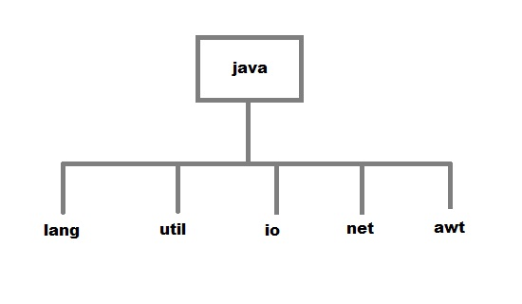
Cont..
Subpackage
A package created inside another package is known as a subpackage.
When we import a package, subpackages are not imported by default. They have to be imported explicitly.
Eg:
import java.util.*;(util is a subpackage inside java package)
import javax.swing.Jbutton;?
import java.io.*;?
import javax.swing.ActionListener;?

Slide 31
Import and Static Import
Import :
It facilitates accessing any static member of an imported class using the class name.
import java.lang.Math;
public class Eg1 {
public static void main(String args[]) {
double val = 64.0;
double sqroot = Math.sqrt(val);
System.out.println("Sq. root of " + val + " is " + sqroot);
}
}

Slide 32
Cont…
Static Import
It facilitates accessing any static member of an imported class directly i.e without using the class name.
import static java.lang.Math.*;
public class Eg2 {
public static void main(String args[]) {
double val = 64.0;
double sqroot = sqrt(val);
System.out.println("Sq. root of " + val + " is " + sqroot);
}
}

Slide 33
User defined packages
Creating a package in java is quite easy.
Simply include a package command followed by name of the package as the first statement in java source file.
package RelationEg;
However, because of new editors we can simply create using GUI wizard
R->click on ur project
New java-package
Then you can create many-related classes in it

Slide 34
package REL1;
public class Comp1 {
public int getMax(int x, int y) {
if ( x > y ) {
return x;
}
else {
return y;
}
}
}

Slide 35
package packageeg;
import REL1.Comp1;
public class EgComp {
public static void main(String args[]) {
int val1 = 7, val2 = 9;
Comp1 comp = new Comp1();
int max = comp.getMax(val1, val2); // get the max value
System.out.println("Maximum value is " + max);
}
}

